Slide 1
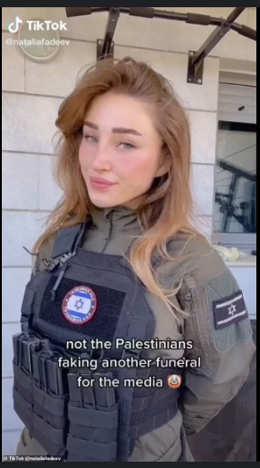
Defending the “Right to Exist”: Is celebrity Zionist social media the newest development in digital nationalism?
By Emmett M

Slide 2
Introduction
(And some housekeeping)

Slide 3
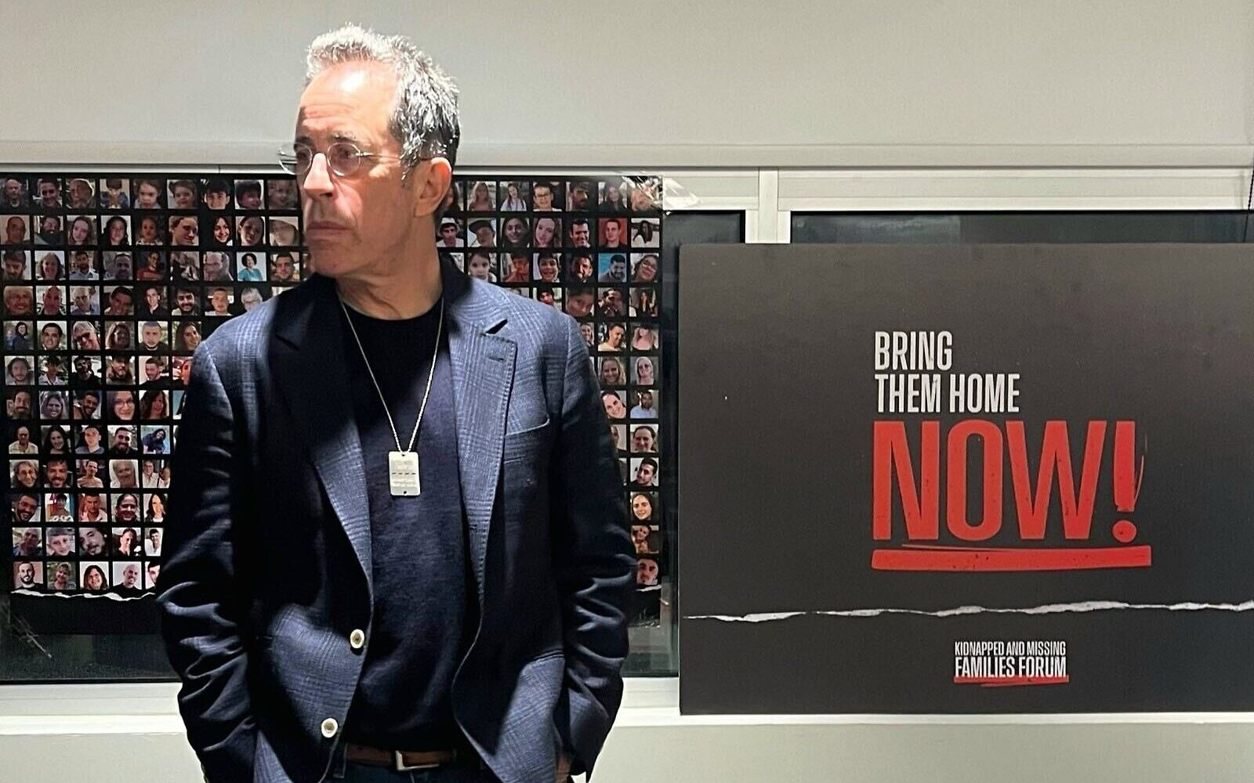
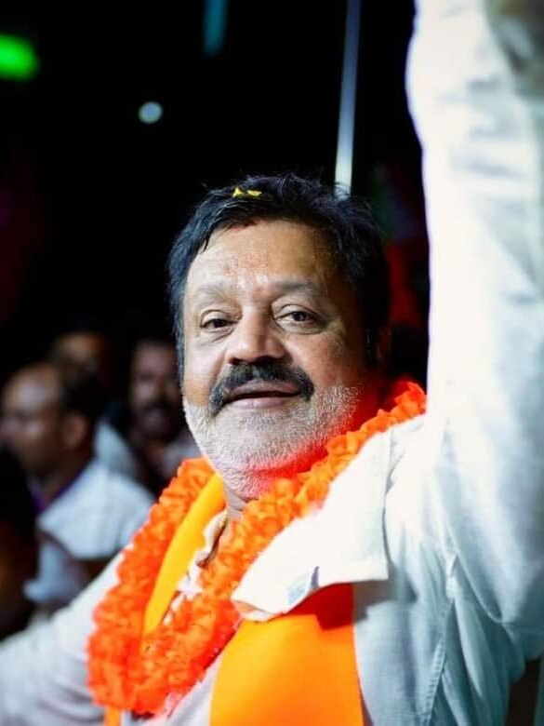
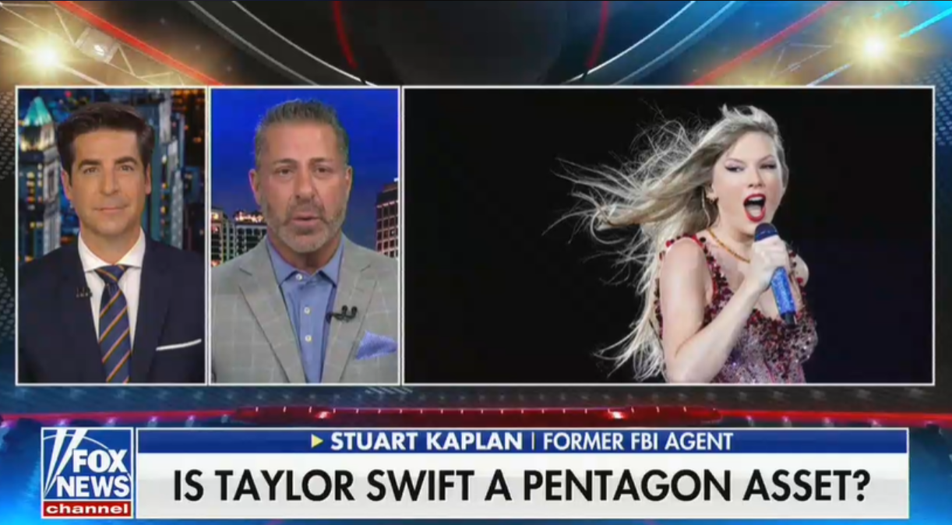
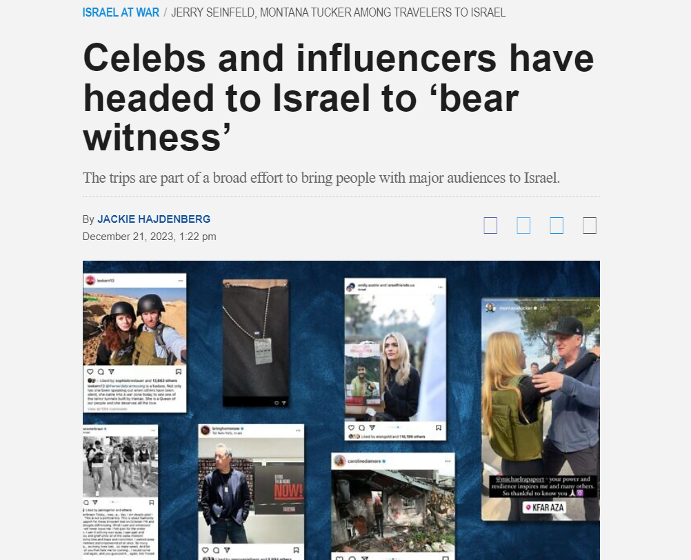
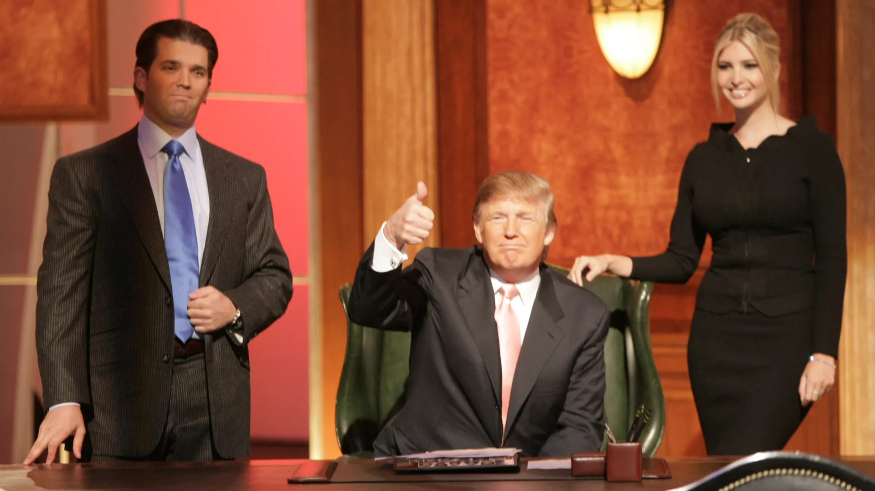
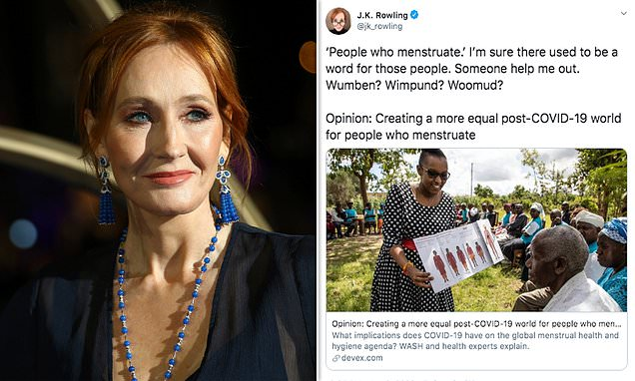
Did you mean: who are the political elite anyway?

Slide 4
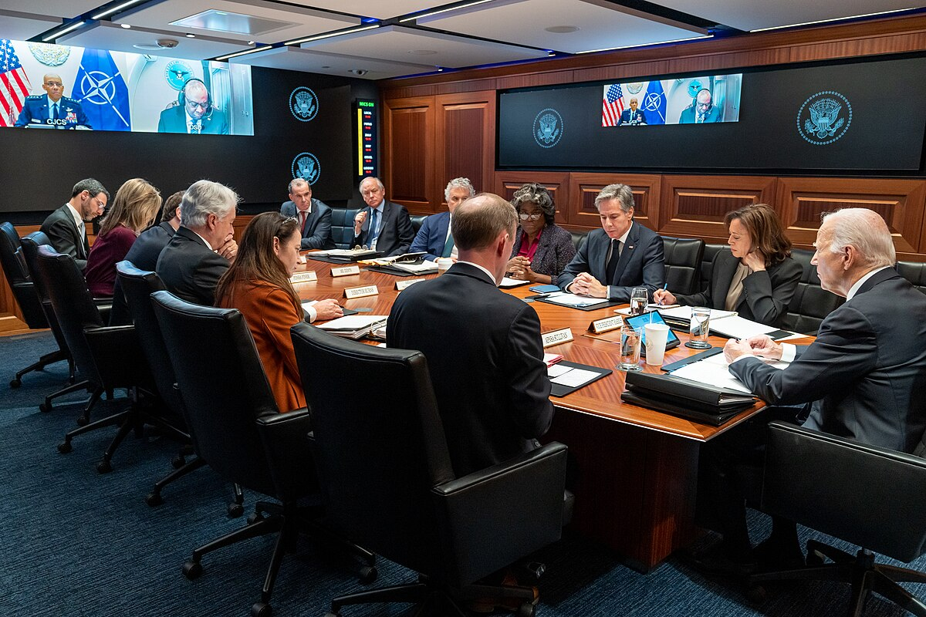
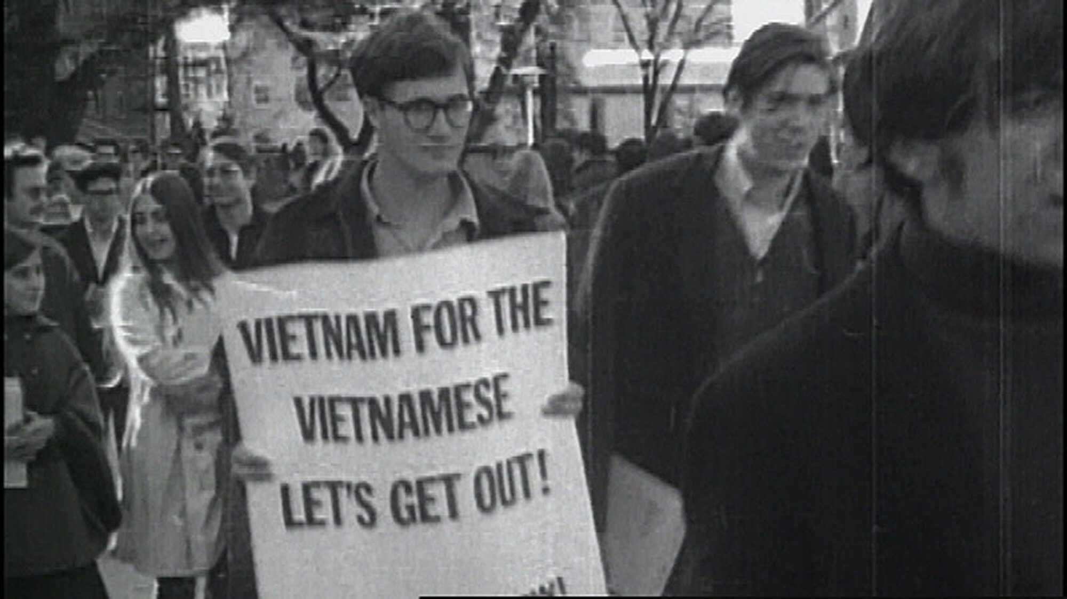
Earlier political communication theories: political elites vs “mediatisation”
Development of broadcast media industry
“Vietnam war thesis”
Suggests mass media proliferation shaped collective response and subsequent policies towards the Vietnam War
Political elite theories
Suggests both information and policy is determined by a closed loop of elites

Slide 5
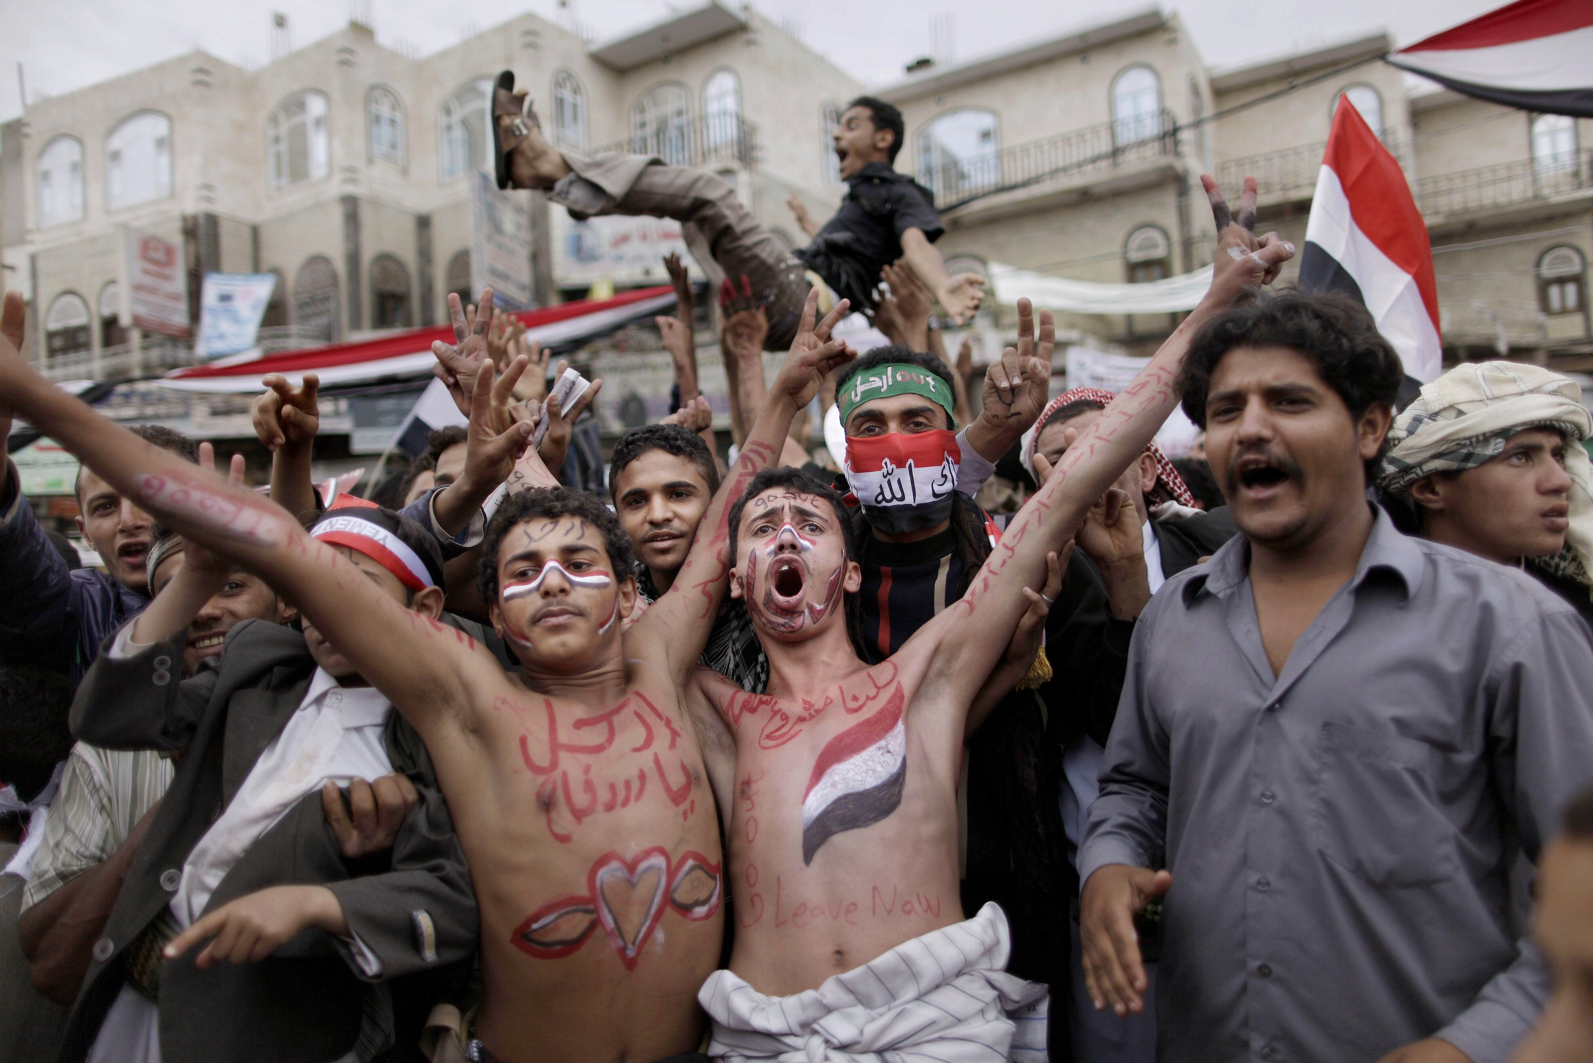

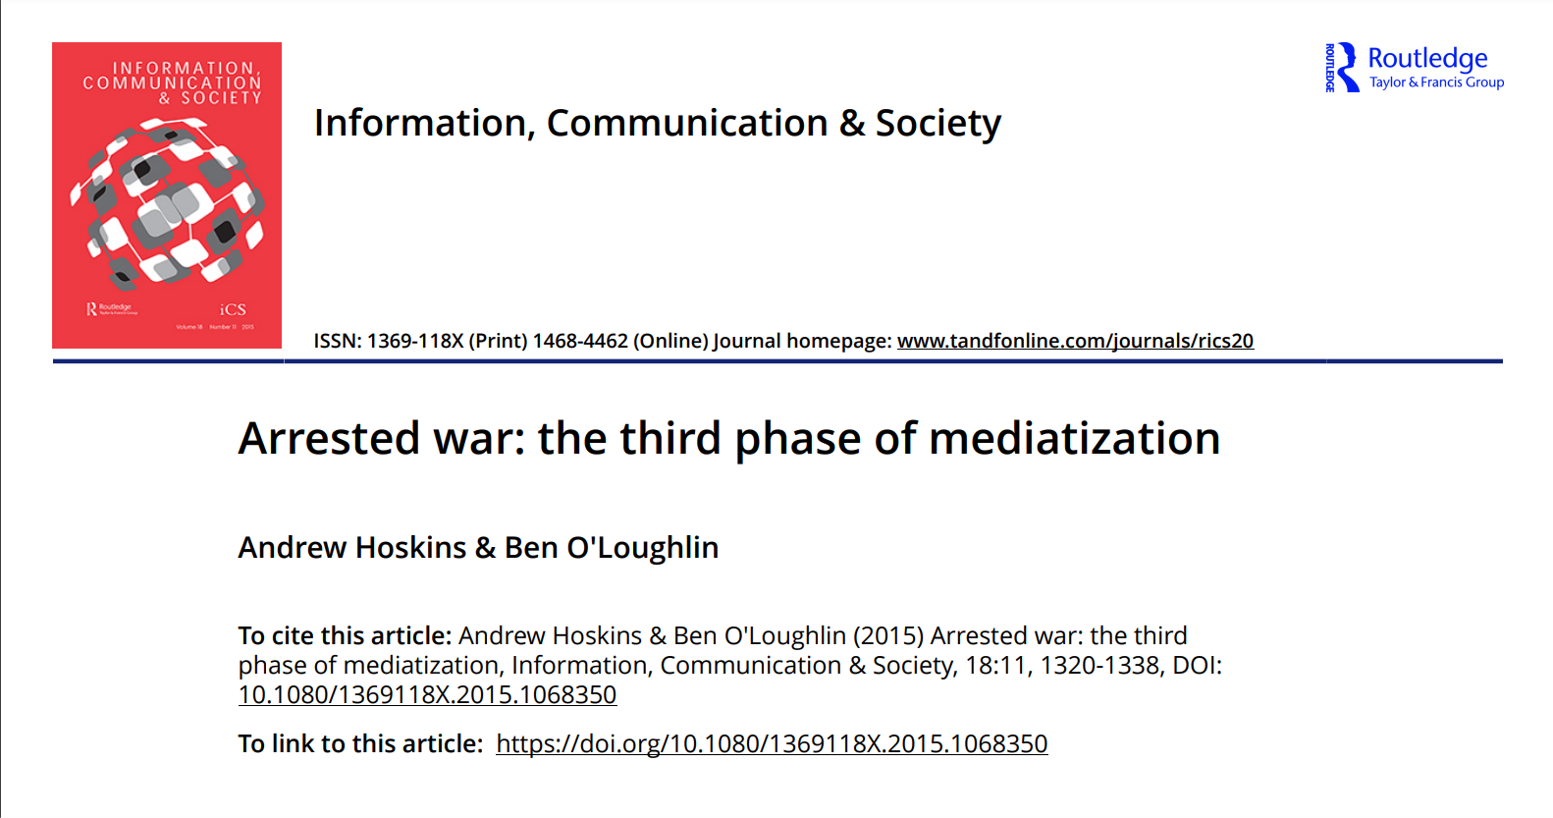
Contemporary political communication: the failure of “digital witnessing”?
“Arab spring” thesis (early 2000s)
Suggests that the increased interconnectivity of social groups and visibility leads to greater democratisation
Stein (2021)
Examines how visibility did not bring mass mobilisation but rather a pattern of obfuscation
Hoskins et al (2015)
Suggests that the increased interconnectivity actually has the opposite effect – audiences begin to rely on “old school media” during times of warfare

Slide 6

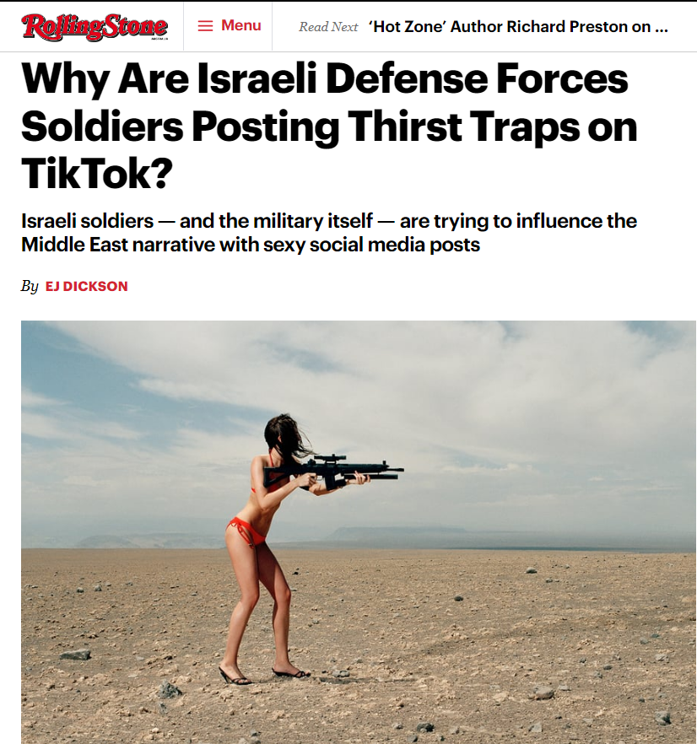
What can we say for certain about political communications?
There’s more information than ever, and perhaps most of it is garbage (and yet we’re all still tuned in) – Reuters Oxford Media Institute
Nations actually do have a vested interest in how people are responding online, whether its overtly asking citizens to participate in digital patriotism (Stein, 2021) or covertly utilising disinformation campaigns with influencers (Woolley, 2021). How effective is this really?
Nothing is clearly delineated anymore. States are brand names (Getzoff 2020), content sponsors (Balint 2020), and online disinformation agents (Woolley, 2022)
Additionally, social media warps how information must be received and who it comes from. Military is entertainment, violence is content, and it lives on long past political events
So how do we make sense of this mess?

Slide 7
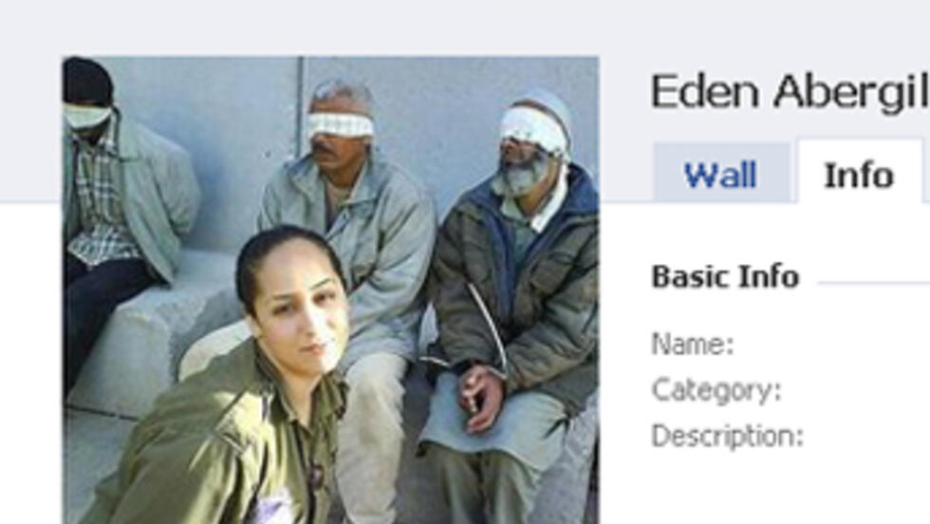

Theoretical framework: digital nationalism
Previous studies:
Set of newer practices (such as the production of propaganda, rituals of allegiance and symbolism) mediated by the digital space to further nation’s legitimacy
Perhaps more fragmented, more polarised, and more innovative than previous forms of nationalism?
What im studying:
Perhaps the digital nature of these spaces means security, economy and brand image all collide?
Perhaps this requires nations to engage in a pattern of denial or obfuscation in response to digital witnessing?
Perhaps it requires nations to use competing claims for legitimacy, considering how polarised and fragmented online audiences are?

Slide 8

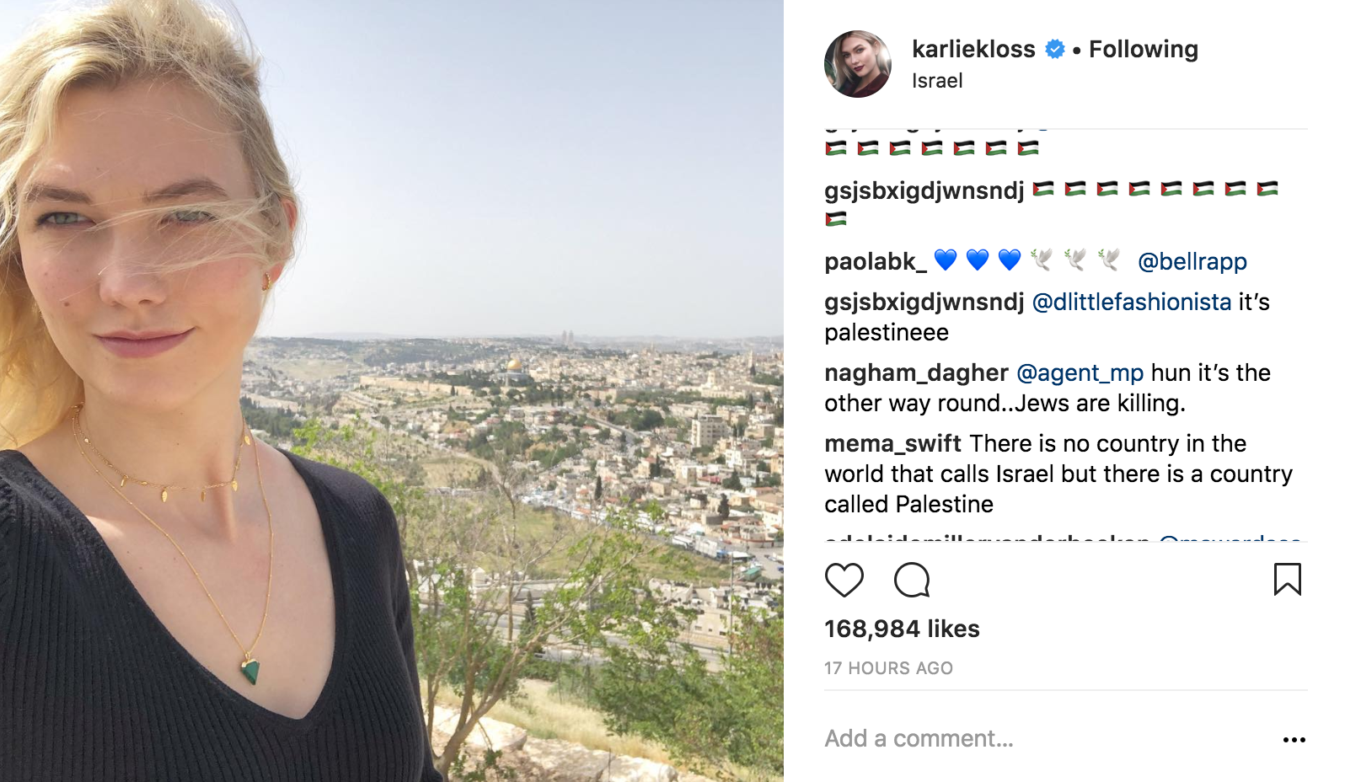
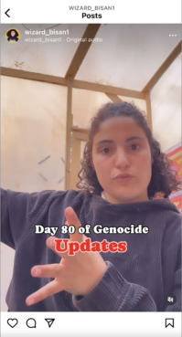
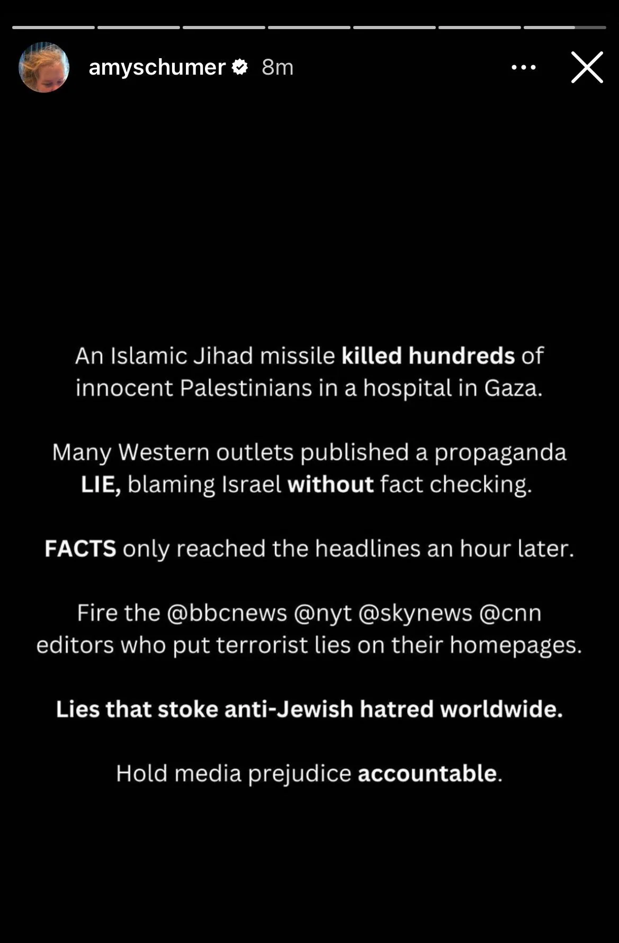
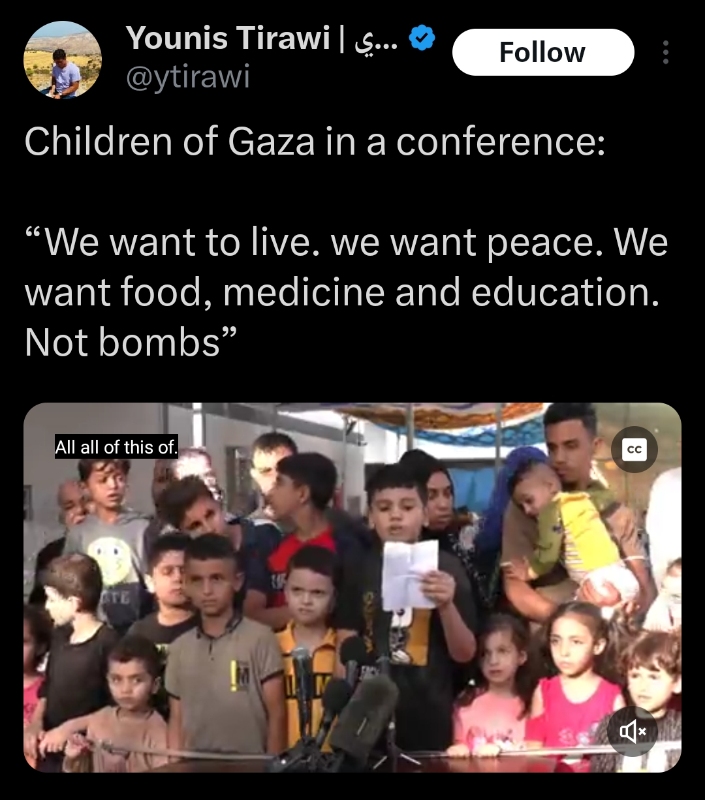
The case study: why the Oct 7th counter offensive?
Situation unprecedented – Israel routinely condemned, casualties estimated to be over 37,000
Mainstream outlets largely found unreliable
Palestinians relying heavily on digital witnessing while Zionists are more fragmented
Striking disparity in access, perception of threats, and claims to nationhood
Is this perhaps a “global” conflict in terms of mobilisation?
#BringThemBack
#IStandWithIsrael
Antisemitism, Terrorism

Slide 9
The case study: why celebrities???????
One explanation: average nationalist individuals? Nothing to see here.
OR: are celebrities perceived as particularly powerful digital citizens, with potential to weild greater soft power? Could this be because they are not conventional political figures?
Bristman (2002) “"The US-based diaspora is of critical importance to Israelis’ feelings of security, to Israel’s deterrence capabilities, and to its ability to craft diplomatic and mili- tary alliances.“”

Slide 10
Evolving (and contradictory) rhetoric
Appeal to apolitical stances vs calls for greater escalation
Appeal to broad humanitarian agenda vs historical exceptionalism for the holocaust
Inability to define “terrorist” versus “civilian Palestinian”
Flattening of both Jewish and Palestinian identities
Reference to constant existential threat, usually tied to inherent dehumanisation of Palestinians
Conflation of antisemitism to antizionism
Appeal to individual discernment (e.g, “I’m going to go see for myself, do not trust anything heard in the news”) vs speaking from a place of authority
Unclear policy creation involvement: speaking as a private individual vs Israeli government affiliated individual

Slide 11
Hypothesis: celebrities present a potent case study on how the conflation of security, economy and digital visibility allows even external subjects to successfully practice digital nationalism
Potential findings:
Influence real but not new: celebrity involvement is not deep enough nor compelling enough to form “digital nationalism”
New but not influential: celebrities are actually not powerful enough to influence external audiences, digital nationalism is mostly domestic
The Taylor Swift paradigm: neither new nor influential, everyone just likes talking about it

